Slide 1



WALMART PREP
Alvina Bohora, Namaswini Teegala & Shrey Mishra​

Slide 2
GOT A PARTY TO PLAN JUST LET US KNOW ABOUT THE EVENT AND WE GOT IT COVERED
“
”
Walmart

Slide 3
PROBLEM IDENTIFICATION
By Alvina Bohora
With any gathering around the corner the only thing you can think of is all the hassle and pre-planning required to organize it, even the smallest gathering requires you to plan your meals, decorations, party essentials etc. way before the event in order to get the supplies.
We at Walmart are here to make your life easy with our new feature of “Walmart Prep”
Notes:
Problem Identification:
With any gathering around the corner the only thing you can think of is all the hassle and pre-planning required to organize it, even the smallest gathering requires you to plan your meals, decorations, party essentials etc. way before the event in order to get the supplies.
We at Walmart are here to make your life easy with our new feature of “Walmart Prep”
Events usually leads to lot of stress with grocery shopping, decorations etc. these often results in being tired during the main event, taking sometime off from work, going to a number of stores to find all the ingredients, not getting all supplies in one place. etc

Slide 4
WALMART PREP
What we do?
Customer need to give the event name, our Generative AI Technology will come-up with the meal suggestions, decorative options, any party essentials and other suggestions that suits the occasion. Customer just needs to select or indicate their interests and give an input on the no. of people attending the event.
We would then add all the ingredients of the meal with proper quantity according to the no. of attendees along with other customer selected items to your shopping cart and deliver it on your doorsteps.
Notes:
Walmart Prep:
What we do?
Customer need to give the event name, our Generative AI Technology will come-up with the meal suggestions, decorative options, any party essentials and other suggestions that suits the occasion. Customer just needs to select or indicate their interests and give an input on the no. of people attending the event.
We would then add all the ingredients of the meal with proper quantity according to the no. of attendees along with other customer selected items to your shopping cart and deliver it on your doorsteps.
eg: Christmas Dinner/ Thanksgiving : Suggestions like turkey with stuffing, mashed potatoes, gravy, cranberry sauce, and vegetables etc choose from these add the no of people attending and we will all the ingredients of all the dishes with appropriate quantity, thus be away from hassle and spend some time on things that matter thus creating memories for life.
One-stop-shop for party essentials: Walmart Prep can be a one-stop-shop for customers to purchase all their party essentials, such as food, drinks, decorations, and party supplies, in one convenient place. This will save customers time and reduce the hassle of going to multiple stores to find everything they need.
Customized party packages: Walmart Prep can offer customized party packages based on the customer's needs and preferences. For example, customers can choose from pre-made packages for different types of gatherings, such as birthday parties, graduation parties, or family reunions. They can also customize their own package by selecting the specific items they need.
Online ordering and delivery: Walmart Prep can allow customers to order their party supplies online and have them delivered to their doorstep. This will eliminate the need for customers to physically go to the store and carry heavy items back home.
Personalized party planning assistance: Walmart Prep can offer personalized party planning assistance to customers. Customers can consult with a party planning expert to help them plan their event, choose the right supplies, and stay within their budget.
Same-day pickup: Walmart Prep can offer same-day pickup for customers who prefer to pick up their party supplies in-store. Customers can order online and have their items ready for pickup at their nearest Walmart location within a few hours.
Competitive pricing: Walmart Prep can offer competitive pricing on party supplies to attract customers and encourage them to choose Walmart as their go-to destination for party planning.

Slide 5





About Us
Locations
Department
Delivery
Convenience
Technology
5,317+ Stores across US
10+ Department catering to all needs
Easy Delivery options
Order as per your Convenience
New Age AI Generative Technology
Notes:
About us:
we have about 5317+ store locations all across US,our stores consist of 10+ department to cater all your needs,we have easy delivery options with walmart subscription,and order as per your requirement at your convenience with our newest technology of AI we provide suggestions for any event preparations.

Slide 6
PartyPal
We have expanded the idea of Walmart Prep to a platform named PartyPal.
What we do? Customer need to give the event name, our Generative AI technology will come-up with the meal suggestions, decorative options, any party essentials and other suggestions that suits the occasion. Customer just needs to select or indicate their interests and give an input on the no. of people attending the event.
We would then add all the ingredients of the meal with proper quantity according to the no. of attendees along with other customer selected items to your shopping cart and deliver it on your doorsteps. We have an option where the customer can now choose from various participating firms that it would like to get a delivery from.
By Alvina Bohora

Slide 7
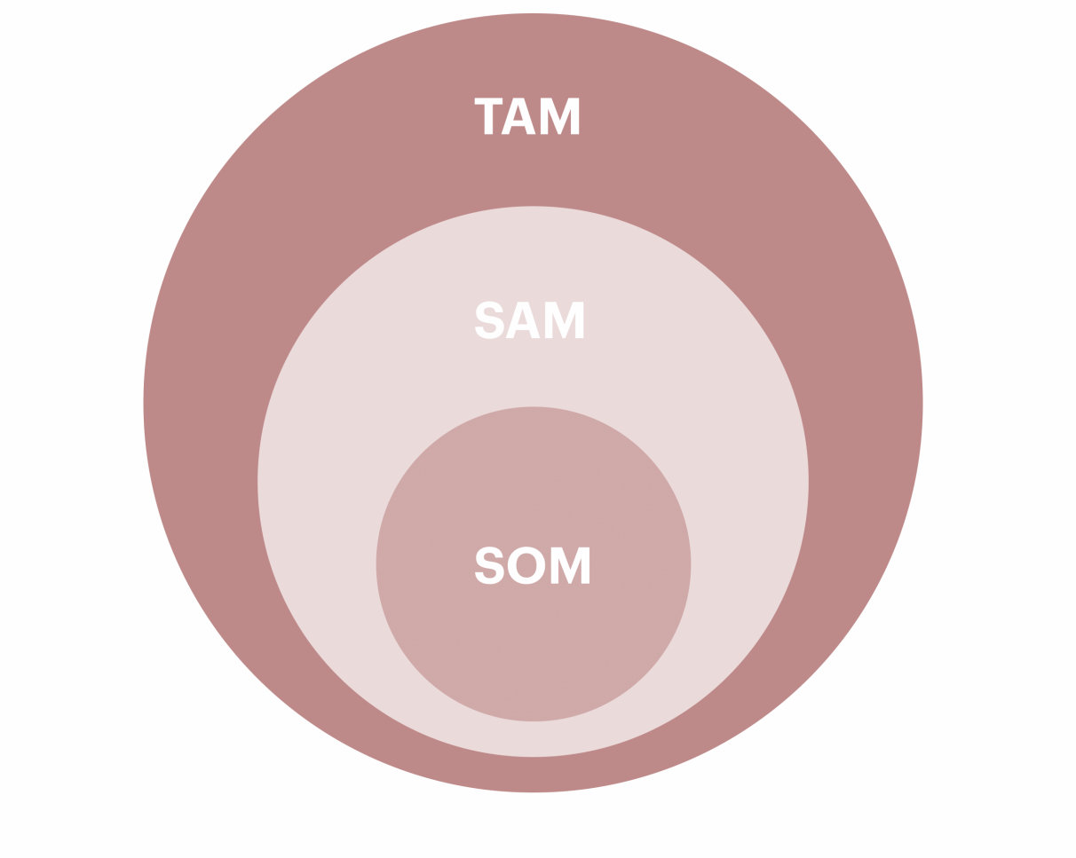
TAM/ SAM/ SOM
TAM will be 300 million potential customers .
SAM will be 10-20 million potential customers.
SOM of 1-2 million potential customers
Notes:
According to the National Retail Federation, there were approximately 3.8 million retail establishments in the US. This includes a wide range of businesses, such as department stores, grocery stores, specialty stores, and e-commerce retailers, Walmart has more than 265 million customers globally who shop at its stores and online, Target has reported having around 30 million unique visitors per week to its stores and website. Amazon has reported having over 300 million active customer accounts worldwide. The potential customer base for local grocery apps in the USA will vary depending on factors such as the size of the app's service area, the population density of that area, and the competition in the market.
The SAM would depend on the platform's target market and geographic area. If the platform focuses on serving customers in major metropolitan areas in the US, the SAM may be in the range of 10-20 million potential customers.
he SOM would depend on the platform's ability to effectively target and attract customers. Assuming the platform is able to effectively market itself and provide a high-quality service, it could potentially capture a significant share of the SAM, If the platform captures 10% of the SAM, it could have a SOM of 1-2 million potential customers.

Slide 8
5c’s Analysis
Customer
Partypal targets customers who want a hassle-free and convenient way to plan events requiring catering, decorations, and other party essentials.
Company
Partypal collaborates with participating firms to deliver items to customers' doorsteps and offers unique Generative AI technology to suggest meal options, decorations, and party essentials.
Collaborates
Partypal collaborates with participating firms providing catering, decorations, and other party essentials, as well as delivery partners.
Competitors
Partypal competes with other event planning platforms such as Eventbrite and Evite, but its Generative AI technology and collaboration with participating firms provide a competitive advantage.
Context
Partypal caters to the growing trend of online event planning and the increasing demand for convenience and hassle-free services, particularly during the COVID-19 pandemic.
Notes:
Customer: The target customers for Partypal are those who are looking for a hassle-free and convenient way to plan and organize their events. They are individuals who are pressed for time, want to avoid the stress of event planning, and would like to rely on a platform to take care of their needs. Partypal caters to customers who want to host events that require catering, decorations, and other party essentials.
Company: Partypal is a platform that provides end-to-end event planning services. Its unique selling point is its Generative AI technology, which provides meal suggestions, decorative options, and other party essentials, based on the customer's input on the number of attendees and their interests. Partypal partners with various participating firms to deliver the required items to the customer's doorstep.
Collaborators: Partypal collaborates with participating firms that provide catering, decorations, and other party essentials. The participating firms benefit from this partnership by gaining access to a wider customer base and increased business opportunities. The platform also collaborates with delivery partners who deliver the items to the customer's doorstep.
Competitors: The competition for Partypal comes from other event planning platforms that offer similar services, such as Eventbrite and Evite. However, Partypal's unique selling point of Generative AI technology sets it apart from its competitors. Partypal's collaboration with participating firms is also an advantage over its competitors, as it provides a wider variety of options for the customer.
Context: The context for Partypal is the growing trend of online event planning and the increasing demand for convenience and hassle-free services. The COVID-19 pandemic has also accelerated the trend towards online event planning, as people are avoiding physical gatherings and opting for virtual events. Partypal caters to this growing trend by providing end-to-end event planning services that are convenient and hassle-free.

Slide 9
Porter five forces
Threat of New Entrants:
The event planning industry is highly competitive, and the barrier to entry is relatively low. However, Partypal has an advantage due to its unique Generative AI technology and collaboration with participating firms.
Bargaining Power of Suppliers:
The suppliers of catering, decorations, and party essentials have some bargaining power as they are essential for the functioning of our business.However, Partypal's collaboration with multiple suppliers helps to reduce the suppliers’ bargaining power.
Bargaining Power of Customers:
Customers have some bargaining power as there are several event planning platforms available. However, our unique Generative AI technology and collaboration with participating firms can provide a competitive advantage over other platforms.
Threat of Substitutes:
There are many substitutes available for event planning services, such as planning the event oneself or hiring an event planner. However, our unique Generative AI technology and collaboration with participating firms can provide a convenient and hassle-free experience for customers, reducing the threat of substitutes.
Competitive Rivalry:
Partypal faces competition from other event planning platforms such as Eventbrite and Evite. However, Partypal's unique Generative AI technology and collaboration with participating firms can provide a competitive advantage over its competitors.
Notes:
Threat of New Entrants: The threat of new entrants for Partypal is relatively low due to the high initial investment required to develop the Generative AI technology and the complex logistics of partnering with participating firms for catering, decorations, and other party essentials. Moreover, building a loyal customer base takes time and effort, which is another barrier to entry.
Bargaining Power of Suppliers: Partypal relies on participating firms for its supplies, including catering, decorations, and party essentials. These firms have significant bargaining power, as they can easily switch to other platforms if they are not satisfied with the partnership terms. Therefore, it is essential for Partypal to maintain a good relationship with its suppliers and ensure that their needs are being met.
Bargaining Power of Customers: The bargaining power of customers is moderate. Customers have the option to choose from different participating firms and can switch to other platforms if they are not satisfied with the services provided by Partypal. However, the unique Generative AI technology and convenience offered by Partypal may help retain customers.
Threat of Substitutes: The threat of substitutes for Partypal is moderate. Customers can choose to plan events on their own, which may be time-consuming and stressful. They can also use other event planning platforms or hire professional event planners. However, the convenience and ease of using Partypal's Generative AI technology may outweigh the benefits of doing it on their own or using other platforms.
Competitive Rivalry: Partypal faces competition from other event planning platforms such as Eventbrite and Evite. However, its unique Generative AI technology and collaboration with participating firms provide a competitive advantage. The market for online event planning is growing, and there is room for multiple players to coexist. However, Partypal must continue to innovate and improve its services to stay ahead of its competitors.

Slide 10




SWOT Analysis By Alvina Bohora
Strength
Weakness
Opportunity
Threat
Time Saving & Convenience: Our biggest strength is our offering that helps clients save time and plan any event hassle-free.
Our AI Technology: there is no platform in the market currently using AI in this field.
Great variety of companies to choose from.
Ability to customize.
We have to have a strong dataset for serving our customers and have to keep on updating it as per changing customer preferences.
We have to retain strong IT team and AI experts to be able to handle any technical challenges.
We have to take care that our cost should not exceed a certain limit as easy to get expensive very fast.
To be able to expand and serve to all cultural specific needs. (e.g. our clients can get all their cultural specific groceries, festival essentials etc)
Partnership opportunity with different stores and platform.
Partnership with event planners.
Individual websites could be a strong alternative but we are at an advantage of have the AI Technology that they don’t but they might end up implementing AI in their platforms too thus there is a need to be alert.
Loss of clients due to lack of personal touch that they might get from visiting a store.
Notes:
SWOT Analysis
Strength:
Time Saving & Convenience: Our biggest strength is our offering that helps clients save time and plan any event hassle-free.
Our AI Technology: there is no platform in the market currently using AI in this field.
Great variety of companies to choose from.
Ability to customize.
2) Weakness:
We have to have a strong dataset for serving our customers and have to keep on updating it as per changing customer preferences.
We have to retain strong IT team and AI experts to be able to handle any technical challenges.
We have to take care that our cost should not exceed a certain limit as easy to get expensive very fast.
3) Opportunity:
To be able to expand and serve to all cultural specific needs. (e.g. our clients can get all their cultural specific groceries, festival essentials etc)
Partnership opportunity with different stores and platform.
Partnership with event planners.
4) Threat:
Individual websites could be a strong alternative but we are at an advantage of have the AI Technology that they don’t but they might end up implementing AI in their platforms too thus there is a need to be alert.
Loss of clients due to lack of personal touch that they might get from visiting a store.

Slide 11
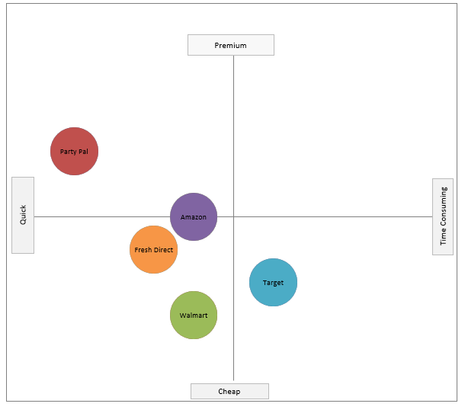
Perceptual Maps:
By Alvina Bohora
We have compared different
firms on the basis of the price
and the delivery time. We feel
that these two factors are
important looking at what
the customers are looking for.
Notes:
Perceptual Maps:
We have compared different firms on the basis of the price and the delivery time. We feel that these two factors are important looking at what the customers are looking for.

Slide 12
4P’s Marketing Mix
Product
Place
Price
Promotions
An AI-based platform to list out all the needs and positioning of products in big box stores
All cities with availability of big box stores such as Target, Walmart and Costco
Beta version to be rolled out to all premium users for testing
Further rollout as an individual paid service apart from the premium app version
Initial promotions through social networks and the premium version of the store's app
After a while promotions through word of mouth and customer loyalty

Slide 13
Segmentation
Working Professionals
Students living Off- Campus
Families living in the city
People with multiple jobs
Day Cares
NYC residents who need to take a trip for such shopping
House Party Animals
Lazy people
like me!!!

Slide 14

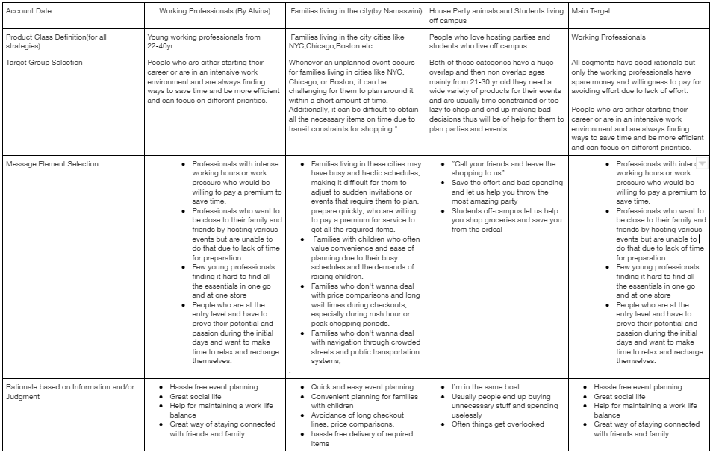
SSO
Notes:
Our primary market segmentation pertains to three categories :
Working Professional – they have intense work hours and want to save time and are more inclined to pay the prices to save them the hassle
Families in the city – people in cities with stores a day trip away, like NYC, Boston, and Chicago. Would use such services to save them time and give more time to families
House Party Animals and Students living Off-Campus – people who love to host parties, dinners, events, etc., but are lazy to shop or don’t have the competency to shop and end up buying useless things and missing useful things; the platform can help them optimize their shopping and satiate their party throwing needs

Slide 15
Mission Statement

Slide 16
Developing a Business Mission
Our Business
Customers
How do we do it
Skills and Capabilities
AI and Software development focussed on optimizing the shopping experience.
People seeking optimized and efficient shopping experiences
Leveraging generative AI into already existing shopping platforms
AI and data analytics
Retail partnerships
Data Security
Customer satisfaction
Notes:
What business are we currently in?
We are in the artificial intelligence (AI) and software development business, specifically focusing on creating an AI-based platform that generates shopping lists and optimizes the shopping experience for our customers.
Who are our customers, and what are they buying from us?
Our customers are individuals and families seeking a more efficient and streamlined shopping experience. They are buying access to our AI-based platform, which provides personalized shopping list creation, price comparisons, meal planning assistance, and suggestions for sustainable and budget-friendly shopping options.
How does our business go about satisfying our customers’ needs?
We satisfy our customers’ needs by leveraging advanced AI algorithms and large-scale data analytics to provide personalized, context-aware shopping recommendations. Our platform integrates with popular grocery store chains and online retailers to access real-time pricing, inventory, and promotion information, which helps users save time and money. Additionally, we offer user-friendly mobile and web applications that make it easy for our customers to manage their shopping lists, receive recommendations, and track their spending habits.
What skills and capabilities is our business especially good at?
Our business excels at: Developing advanced AI algorithms and machine learning models to analyze user preferences, shopping habits, and market trends. Creating intuitive and user-friendly interfaces for mobile and web applications.Establishing partnerships with grocery store chains and online retailers to ensure accurate and up-to-date information.Implementing robust security and privacy measures to protect user data.Providing exceptional customer support to address any concerns and continuously improve the platform based on user feedback.

Slide 17
Business Area Evaluation
 | Current Business Situation: | Preferred Future:
Business Products or Services | AI-generated shopping with limited optimization | AI-powered platform with increased optimisation and services
Production Practices | Standard generative AI with user feedback | An efficient ever learning user based AI platform
Business Size and Scope | Small team with regional focus | Serve a global audience
Management Structure | Simple lateral structure | Organized structure with several departments
Social Responsibilities | Minimal social impact mainly focusing on optimizing shopping | Minimising food waste, promoting sustainable products and eco friendliness
Work Force (number and skills): | 10-15 people mainly tech and outreach | Diversified teams with all required elements
Notes:
Business Products or Services: Our platform currently offers a basic AI-generated shopping list based on user input and preferences. It provides limited optimization options for the shopping experience.
Production Practices: We are using a standard AI algorithm for creating the shopping list, which is updated occasionally based on user feedback.
Business Size and Scope: We have a small team focused on app development and a moderate user base within our local region.
Markets and Linkages: We are mainly serving the local community with minimal outreach to other markets.
Management Structure: We have a simple management structure with a founder, a technical lead, and a few developers.
Social Responsibilities: Our platform has minimal social impact, focusing solely on helping users make better shopping lists.
Work Force (number and skills): We have a small team of 5-7 members with skills in app development and AI.
Customers: Our primary customers are local individuals and families looking to improve their shopping experience.
Preferred Future:
Business Products or Services: We envision an AI-powered platform offering personalized shopping list generation, optimal store navigation, smart budgeting, and seamless integration with local grocery stores and online retailers.
Production Practices: We aim to develop a sophisticated AI algorithm that continuously learns from user behavior, preferences, and feedback, ensuring a highly efficient and enjoyable shopping experience.
Business Size and Scope: Our goal is to grow the team and scale the platform to serve a global audience, making shopping more convenient for millions of users.
Markets and Linkages: We aim to establish partnerships with local and international grocery stores, online retailers, and delivery services to offer a seamless shopping experience across multiple platforms and regions.
Management Structure: We envision a more structured organization with dedicated teams for product development, marketing, customer support, and business development, all working towards the common goal of revolutionizing the shopping experience.
Social Responsibilities: In the future, we will focus on minimizing food waste by suggesting meal plans, providing information on sustainable products, and promoting eco-friendly shopping practices.
Work Force (number and skills): Our future workforce will be a diverse and skilled group of individuals proficient in AI, app development, marketing, customer support, and business development.
Customers: We aim to cater to a broad range of customers, including individuals, families, and businesses worldwide, who value convenience, efficiency, and sustainability in their shopping experiences.

Slide 18
Desires going forward
Next 10 years
AI-based system optimizes the entire shopping experience for customers
seamlessly integrate with shopping platforms to provide users with pricing, availability, sustainable and ethical sourcing options
New activities and businesses
Pursue partnerships with retailers and manufacturers to offer exclusive deals and promotions to our users
incorporating smart home integration, meal planning, and nutritional analysis features
Potential customers and need satisfaction.
primary customers will be households and individuals who value convenience, efficiency, and personalization in their shopping experience
also cater to small business owners who require assistance in inventory management and procurement
strong global presence and recognition for user-friendly interface, data security, and adaptability to individual preferences and needs
may explore opportunities in inventory management for small businesses, helping them streamline their procurement processes
Strength area
Business will excel at harnessing the power of AI and machine learning to analyze customer data and preferences to provide highly personalized shopping experiences
Will also be proficient in maintaining a user-friendly and intuitive interface, ensuring data security and privacy, and building strong partnerships with retailers and manufacturers to provide exclusive benefits to our users.
Notes:
If our platform could be anything we want in 10 years, what would it be?
In 10 years, our platform would be a highly advanced and intelligent AI-based system that creates personalized shopping lists and optimizes the entire shopping experience for customers. It would seamlessly integrate with various retailers, online marketplaces, and other related services to provide users with accurate pricing, product availability, and sustainable and ethical sourcing options. The platform would have a strong global presence and be recognized for its user-friendly interface, data security, and adaptability to individual preferences and needs.
What new activities will our business be pursuing? What business will we be in?
Our business will expand beyond creating shopping lists and optimize the overall shopping experience. We will be pursuing partnerships with retailers and manufacturers to offer exclusive deals and promotions to our users. We will also be incorporating smart home integration, meal planning, and nutritional analysis features. Additionally, we may explore opportunities in inventory management for small businesses, helping them streamline their procurement processes.
Who will be our customers? What customer needs will our business satisfy?
Our primary customers will be households and individuals who value convenience, efficiency, and personalization in their shopping experience. We will also cater to small business owners who require assistance in inventory management and procurement. Our platform will satisfy customers' needs by saving them time and effort, providing personalized recommendations based on their preferences, and helping them make informed decisions on their purchases.
What will the business be especially good at?
The business will excel at harnessing the power of AI and machine learning to analyze customer data and preferences to provide highly personalized shopping experiences. We will also be proficient in maintaining a user-friendly and intuitive interface, ensuring data security and privacy, and building strong partnerships with retailers and manufacturers to provide exclusive benefits to our users.
What will be the roles and responsibilities of family members and employees involved in our business?
Family members and employees will have clearly defined roles and responsibilities based on their skills and expertise. Some potential roles may include:
CEO: Providing strategic direction and overseeing overall business operations.
CTO: Developing and maintaining the technological infrastructure and ensuring continuous innovation.
Marketing and Business Development: Building partnerships with retailers and manufacturers, and promoting the platform to attract new users.
Customer Support: Addressing customer inquiries and feedback, and providing prompt resolutions.
Data Analysts: Analyzing customer data to improve platform features and personalization.
What do family members and the business value?
Family members and the business value:
Innovation: Continuously improving and evolving our platform to meet the changing needs of customers and stay ahead of the competition.
Integrity: Maintaining transparency in our business practices and prioritizing data security and privacy.
Customer-centricity: Ensuring customer satisfaction by providing personalized and seamless shopping experiences.
Collaboration: Fostering a supportive and inclusive work environment for family members and employees, and building strong partnerships with retailers and manufacturers.
Sustainability: Encouraging responsible consumption and promoting eco-friendly and ethical purchasing options.

Slide 19
MISSION
Our mission is to revolutionize shopping with an AI-driven platform that simplifies and enhances the experience for individuals and families. We focus on personalized recommendations, sustainable and budget-friendly options, and saving time and money, partnering with top retailers to be the preferred solution for more innovative, more efficient shopping.
Notes:
At Party Pal, we revolutionize the shopping experience by providing an AI-driven platform that intelligently curates and optimizes personalized shopping lists for busy, environmentally-conscious, and budget-savvy individuals. Our commitment is to streamline the shopping process, save our customers time and money, and promote sustainable choices for a healthier planet.
What We Do:
We harness the power of artificial intelligence to analyze customer preferences, budgets, and dietary needs, creating customized shopping lists that optimize product selection, purchase frequency, and store recommendations. Our platform offers insights on deals, promotions, and eco-friendly options, ensuring a seamless and efficient shopping experience for our users.
For Whom:
Our services are designed for those who seek to simplify and optimize their shopping experience, including busy professionals, families, students, and individuals aiming to make more sustainable and budget-conscious choices.
Our Uniqueness:
PartyPal AI stands out through our innovative AI technology, which enables us to deliver highly personalized and adaptive shopping recommendations. Our platform not only focuses on the convenience aspect of shopping but also emphasizes sustainable and cost-effective choices, aligning with our customers' values and promoting a healthier planet for future generations.

Slide 20
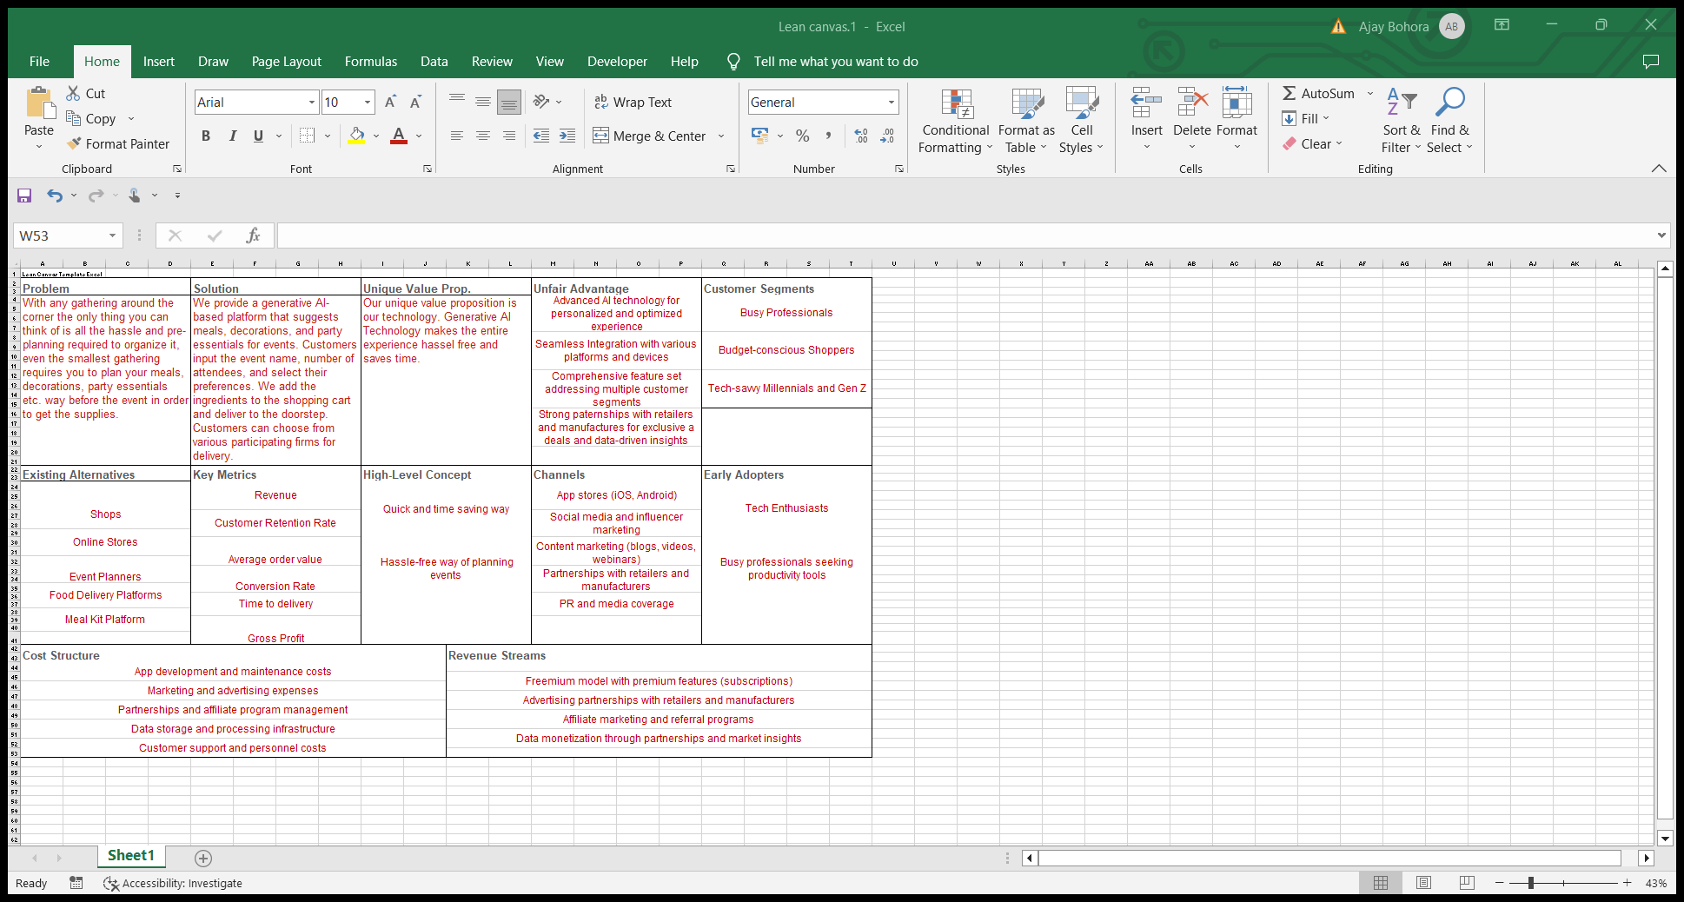
Lean Canvas By Alvina & Shrey
Notes:
Problem:
With any gathering around the corner, the only thing you can think of is all the hassle and pre-planning required to organize it; even the smallest crowd requires you to plan your meals, decorations, party essentials, etc., way before the event to get the supplies.
Solution:
We provide a generative AI-based platform that suggests meals, decorations, and party essentials for events. Customers input the event name and number of attendees and select their preferences.
We add the ingredients to the shopping cart and deliver them to the doorstep. Customers can choose from various participating firms for delivery.
Unique Value Prop.:
Our unique value proposition is our technology. Generative AI Technology makes the entire experience hassle-free and saves time.
Existing Alternatives:
Shops: Traditional brick-and-mortar stores offer in-person shopping experiences but may not provide our AI-based app’s convenience, personalization, and cost-saving features.
Online Stores: While online stores offer convenience and variety, they often need personalized suggestions, budget management tools, and integration with other platforms our app provides.
Event Planners: Professional event planners can help organize events but may not cater to everyday shopping needs and budget management as our app does.
Food Delivery Platforms: These platforms focus on delivering prepared meals but must address grocery shopping, budget management, or personalization like our AI-based app.
Meal Kit Platforms: Meal kit services offer pre-planned meals and ingredients, but they may not provide the flexibility, cost-saving features, and personalization of our app.
Key Metrics:
Revenue: Monitor the overall income generated by our app to assess the business's financial success.
Customer Retention Rate: Track the percentage of users who continue to use our app over time, reflecting user satisfaction and loyalty.
Average Order Value: Measure the average amount users spend per transaction to understand spending patterns and optimize pricing strategies.
Conversion Rate: Analyze the percentage of users who upgrade from the free to the premium version of our app, indicating the perceived value of our premium features.
Time to Delivery: For any delivery-related features, track the average time to deliver products to users, ensuring a timely and efficient service.
Gross Profit: Assess the profitability of our app by calculating the difference between total revenue and the costs associated with providing our services.
High-Level Concept:
Quick and time-saving way: Our AI-based shopping planning app offers users a fast and efficient method to manage their shopping, saving them valuable time and effort.
Hassle-free way of planning events: By streamlining the shopping process, providing personalized suggestions, and offering budget management tools, our app makes it easier for users to plan and organize events, eliminating stress and complications.
Integrated shopping solution: Our app combines the best features of various alternatives, creating a comprehensive and user-friendly platform that caters to a wide range of shopping needs, preferences, and budgets.
Unfair Advantage:
Our advanced AI technology sets us apart from competitors, offering personalized and optimized shopping experiences that adapt to individual preferences.
Seamless integration with various platforms and devices ensures compatibility with users' digital lifestyles and enhances user experience.
Our comprehensive feature set caters to multiple customer segments, increasing our app's appeal to a broad audience.
Strong partnerships with retailers and manufacturers enable us to provide exclusive deals and leverage data-driven insights for continuous improvement.
Channels:
We will distribute our app through popular app stores, such as iOS and Android, reaching users globally.
Social media and influencer marketing will help us generate buzz and increase app downloads.
Content marketing, including blogs, videos, and webinars, will showcase our app's features and benefits, attracting potential users.
Partnerships with retailers and manufacturers will enhance our offerings and expand our user base.
PR and media coverage will help build our brand reputation and credibility.
Customer Segments:
Our primary customer segments include busy professionals, budget-conscious shoppers, tech-savvy millennials, and Gen Z.
By understanding each segment’s unique needs and preferences, we tailor our app to provide a customized shopping experience, enhancing user satisfaction and loyalty.
Early Adopters:
Early adopters may include tech enthusiasts, budget-conscious individuals seeking innovative shopping solutions, and busy professionals looking to save time and energy.
Engaging these early adopters can help us refine our app, identify areas for improvement, and generate positive word-of-mouth marketing.
Cost Structure:
High costs include app development and maintenance, ensuring a reliable and up-to-date user experience.
Marketing and advertising expenses will be required to promote our app and attract new users.
Managing partnerships and affiliate programs will incur costs but contribute to our revenue streams.
Data storage and processing infrastructure will be necessary to support our app's AI capabilities and user data.
Customer support and personnel costs are essential for maintaining user satisfaction and addressing concerns.
Revenue Streams:
Our freemium model with premium features will drive subscription revenue, allowing users to access exclusive benefits.
Advertising partnerships with retailers and manufacturers will generate additional income by promoting relevant deals and products within our app.
Affiliate marketing and referral programs will provide revenue when users purchase through our app or refer new users.
Data monetization through partnerships and market insights will offer an additional revenue stream, capitalizing on the valuable information generated by our AI technology and user behavior.

Slide 21



MEET OUR TEAM
ALVINA BOHORA
SHREY MISHRA
NAMASWINI TEEGALA

Slide 22
THANK YOU

